Slide 1
American Modular Tooling Product Overview

Slide 2
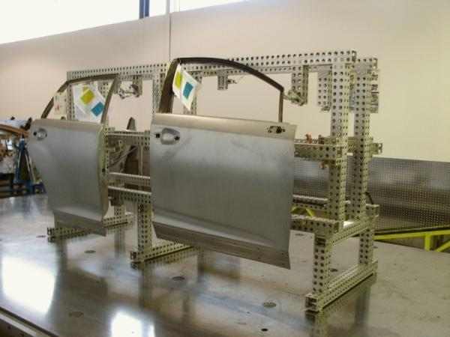
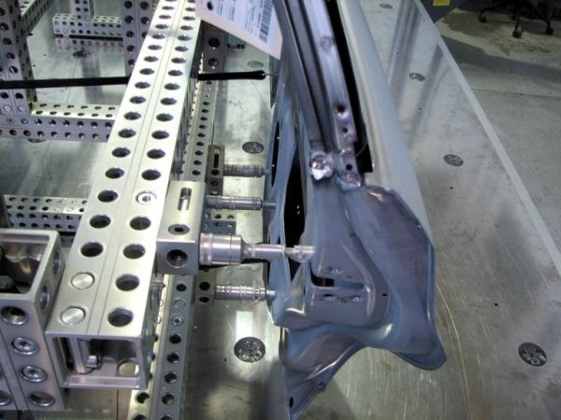
Quality Metal Craft
Frame and Components,
Customer Assembled
It’s easy to learn
It’s like working with one of those Erector® sets you had when you were a kid.
It’s very, very user friendly.
“If it’s going to cost us a measly $3,000.00 to build, say, a $100,000.00 fixture…we
want to do it.”
Quality Metal Craft, Inc.

Slide 3
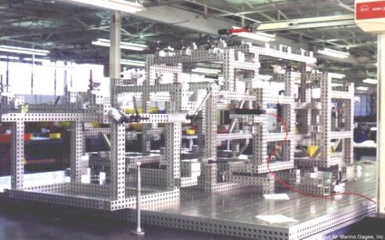
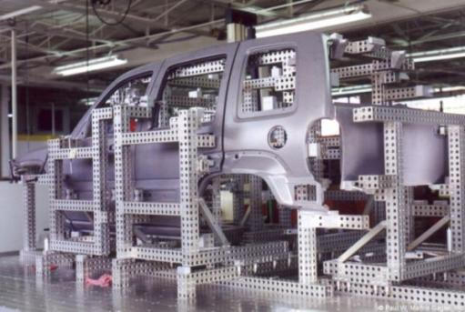
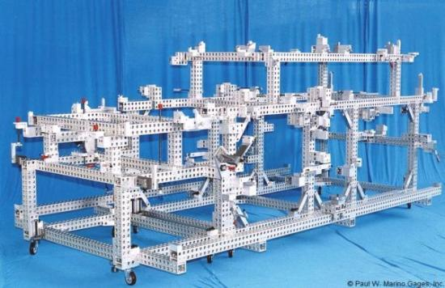
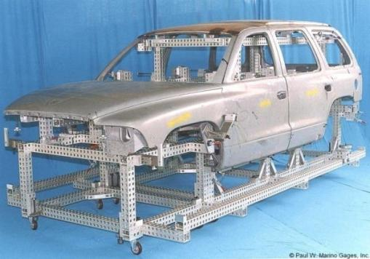
Chrysler, 1994 and 2000
Liberty, in process of build with full modular base plate. | Class A surface nets require 5 sliding units for closures loading.
1994 Durango, 35 day delivery schedule

Slide 4
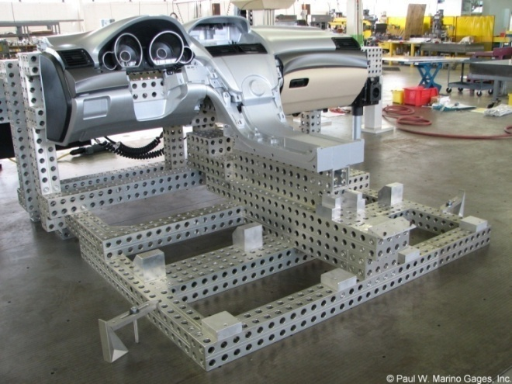
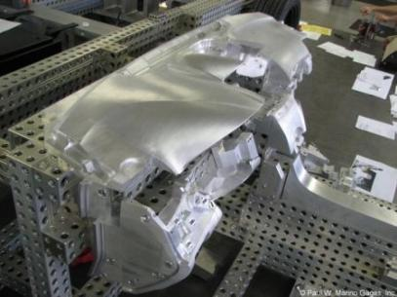
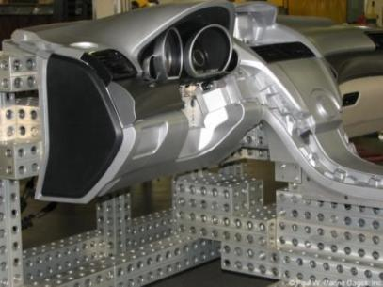
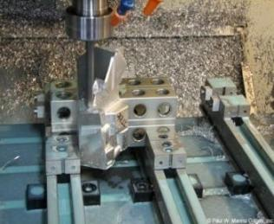
Honda, 2008
Master Interior Buck for Instrument Panel and Center Console.

Slide 5
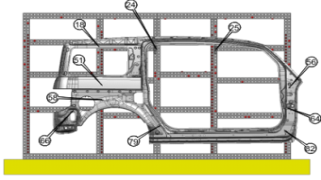
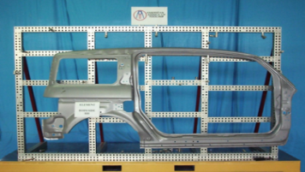
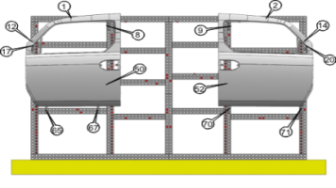
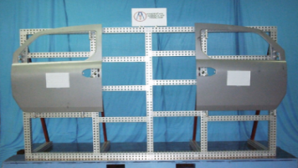
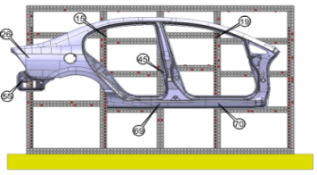
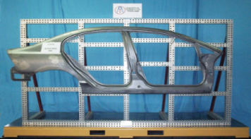
Honda, 2007
Measuring Screen holds 21 different panels using all standard AMT components.
Part A, Operation Procedure and Part
The Tool Kit
Part B, Operation Procedure and Part
The Plan
Part C, Operation Procedure and Part

Slide 6
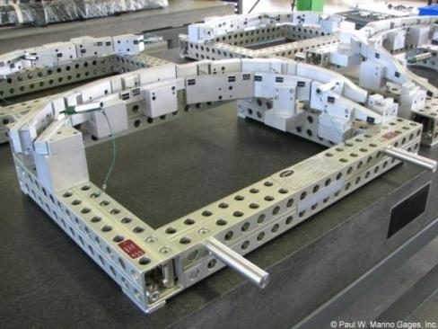
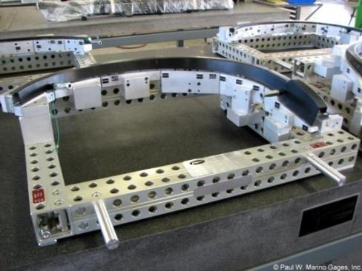
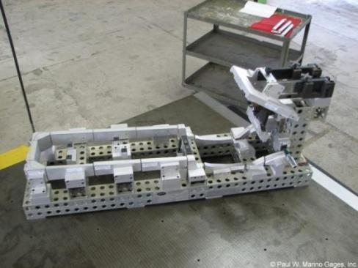
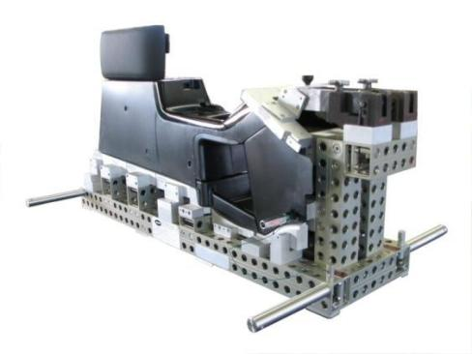
Honda, 2006
Wheel Opening Garnish Molding, 1 R/1 L Front and Rear
Honda, Center Console

Slide 7
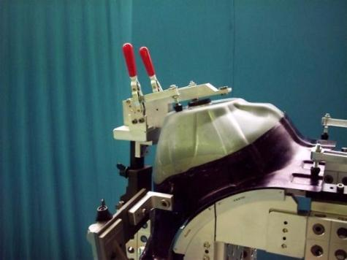
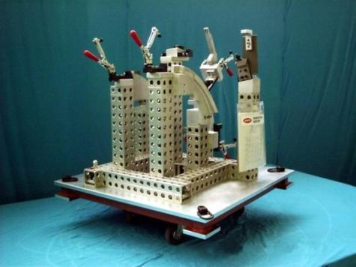
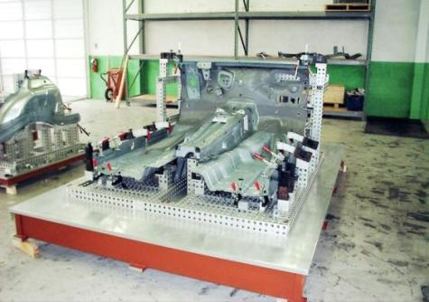
MBUSA/Gestamp USA, 251, 2002-2003
Right and Left Suspension Strut. Tool originally designed for weld, then modified with check rails and SPC checks.
Main Floor Match Check: Engine Compartment, Plenum, Tunnel and Lower Floor

Slide 8
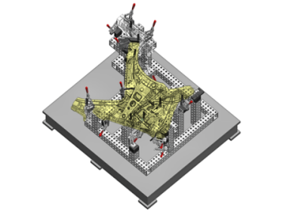
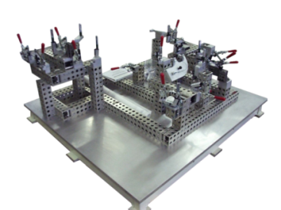
Toyota, 2007
Wheel House, 1R / 1L

Slide 9
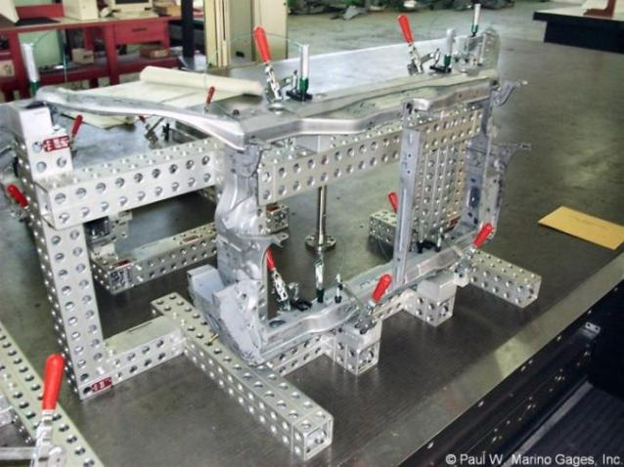
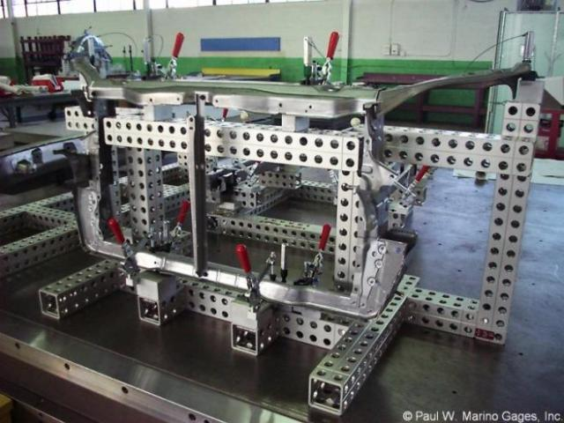
Toyota, 2006
Radiator Support

Slide 10
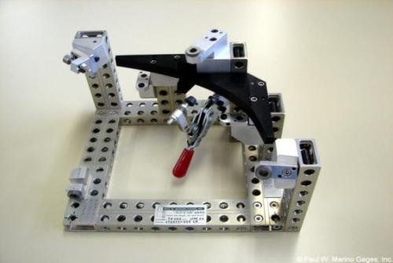
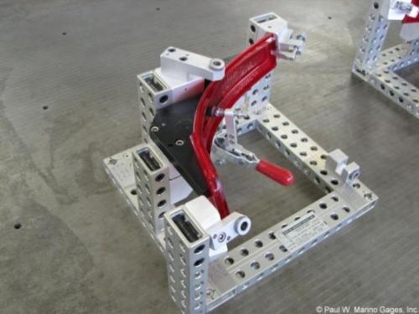
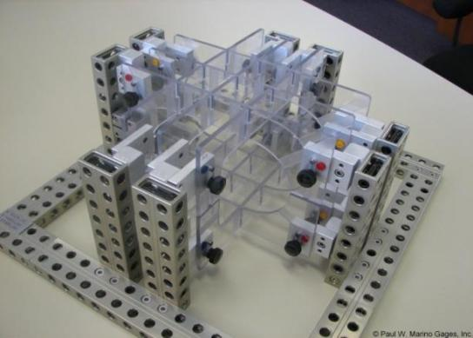
Schefenacker for BMW, 2006
1 Right / 1 Left
Kongsberg / BMW, 2006
Set of four →
Front/Rear, Left / Right

Slide 11
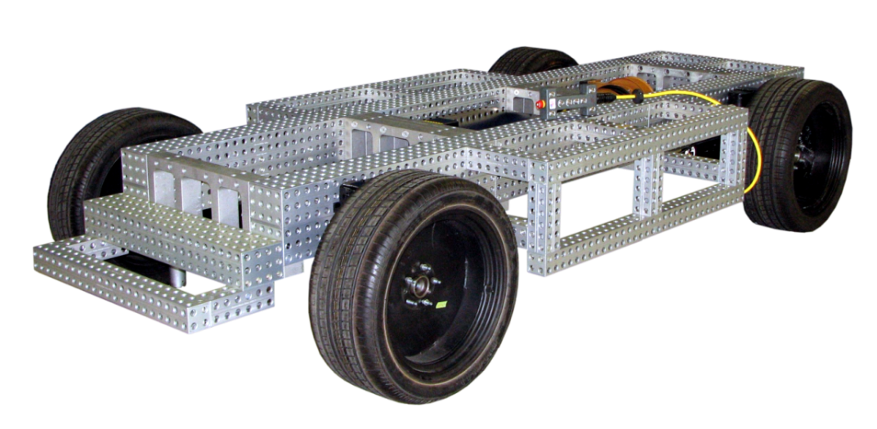
GM Design World Wide Studio Coordination Program
Exterior Armature for Pre-prototype and Prototype Models, 50 units

Slide 12
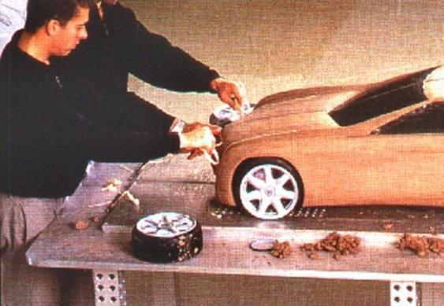
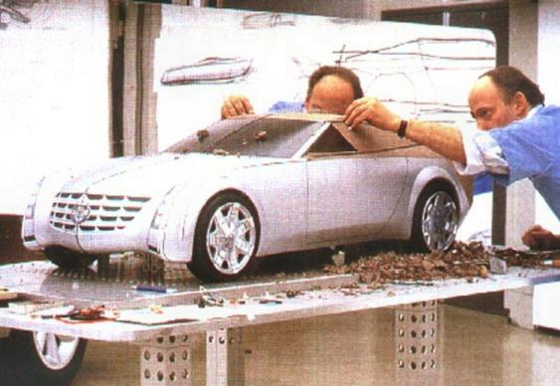
Studio Tools®: A System for Design Studios
Scale Model Mirror Tables

Slide 13
Studio Tools®: A System for Design Studios Utilizing Common Process and Practice
Instrument Panel with Right
and Left Door Armatures,
Milling Stands and Seat
Platform.
Components are Accurately Combined for Interior Buck.
Remove the door stands and the doors are fully functional.

Slide 14
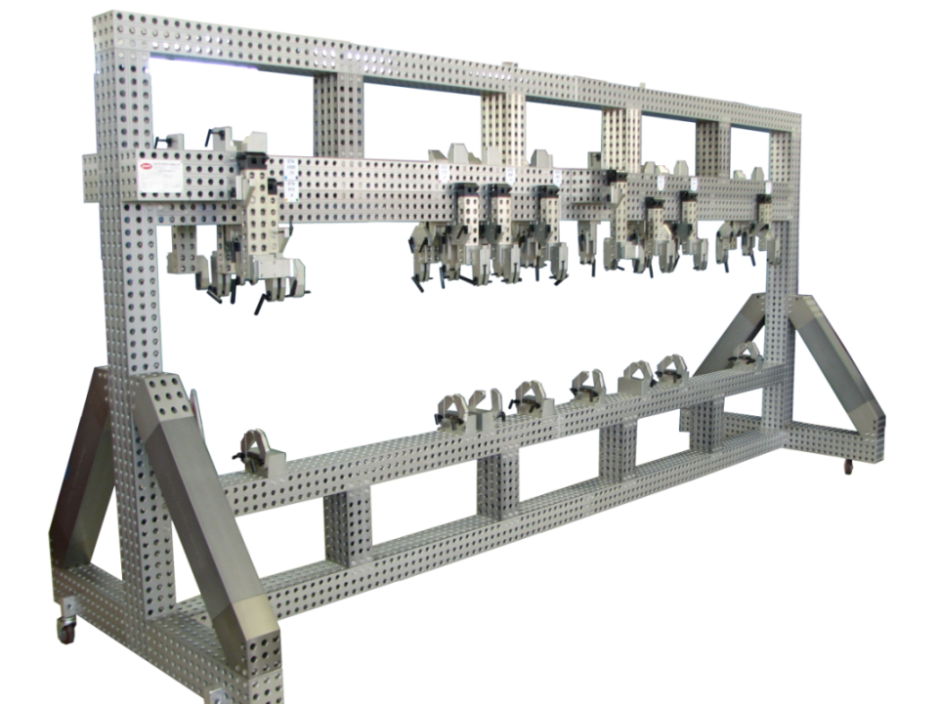
United States of America Air Force (USAF), 2008
Bomb Bay Doors for B52, 1 right/1 left, 1 upper/1 lower, two tools, 4 parts. AMT Special Duty 120 x 160 Hollows. Tool is 4,400mm long x 2,400mm high

Slide 15
Astronetics Company, 2005
Prototype Build, 4 Units

Slide 16
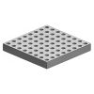
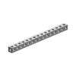
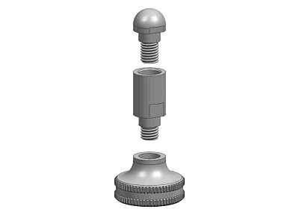
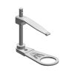
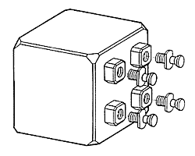
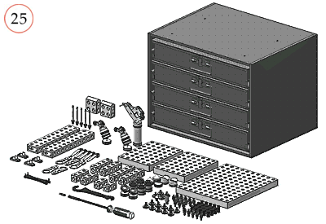
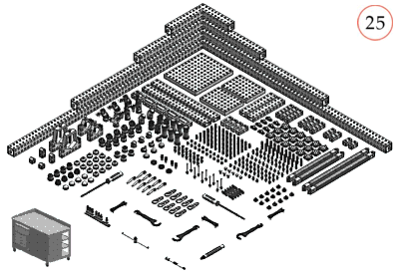
American Modular Tooling Fixture Kits
AMT is sold as individual components, as complete fixtures designed and built to your specifications and also in preconfigured kits designed to accommodate all varieties of fixturing requirements.
All kits include a storage case and the tools needed for assembly.
All American Modular Tooling Components are manufactured 100% in the USA
Base Plates | Hollows | Locators
Clamps | Connectors | Custom Blocks
Preconfigured kits for small to large part fixturing

Slide 17
Benefits of the American Modular Tooling System (compared to traditional fixtures)
Manufacturing and Engineering |  |  | Manufacturing and Assembly
❍ Facility Usage | 48% Less |  | ❍ Assembly Labor | 70% Less
❍ Lead Time | 60% Less |  | ❍ Through-put Increase | 45% More
❍ Tooling Costs | 44% Less |  | ❍ Accuracy of Assemblies | 50% Greater
❍ Tooling Labor | 60% Less |  | ❍ Periodic Inspection | 50% Less
❍ Tooling Design Cost | 50% Less |  | Reconfigurable | Priceless
❍ Equipment Needs | 70% Less |  | Modularity | Priceless
❍ Reusable Material | 70% Reusable |  | ❍ Rapid Engineering Changes | Priceless
Other Benefits
❍ Fewer corrosion problems due to hard coat aluminum |  |  | ❍ Can be used as temporary rate tool
❍ Lower shipping costs due to lighter weight |  |  | ❍ Less space required for storage
❍ Faster setup at customer facility |  |  | ❍ Minimal maintenance requirements
❍ Good ROI on leasing tool (70% reusable) |  |  | ❍ Environmentally correct

Slide 18
PROJECTED SAVINGS / Return on Investment:
Save 25%
AMT
WELDED FIXTURE
DESIGN Our designers are specialists in various fields of fixture design and can receive data via FTP in all typical file formats.
BUILD Everything except custom- machined nets can be re-used to update the model run, or to begin a totally new one.
Save 80%
AMT
WELDED FIXTURE

Slide 19
PROJECTED SAVINGS / Return on Investment:
Save 60%
AMT
WELDED FIXTURE
RAPID TURNAROUND Shortened time frame for design and assembly allows a more comfortable window for changes and adjustments.
RE-USE: Everything except custom- machined nets can be re-used to update the model run, or to begin a totally new one.
Save 90%
AMT
WELDED FIXTURE

Slide 20
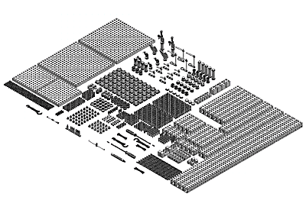
Material Properties of AMT Components
AMT “Professional Grade” Extruded Profiles and Locators |  | AMT “Commercial Grade” Extruded Profiles and Locators |  | AMT Locator and connection Elements
❍ 7075-T6, Temper 6 |  | ❍ 6061-T6, Temper 6 |  | ❍ 2024-T6
❍ KSI Tensile: 78,000 PSI |  | ❍ KSI Tensile: 47,000 PSI |  | ❍ KSI Tensile: 69,000 PSI
❍ KSI Yield: 68,000 PSI |  | ❍ KSI Yield: 40,000 PSI |  | ❍ KSI Yield: 57,000 PSI
❍ Hard Coat Anodized |  | ❍ Hard Coat Anodized |  | ❍ Hard Coat Anodized
❍ Elongation Factor: 6% |  | ❍ Elongation Factor: 8% |  | ❍ Elongation Factor: 10%
AMT “Special Duty” Extruded Profiles |  | AMT “Special Duty” Cast Products
❍ 6082-T6, Temper 6, Special Blend |  | ❍ 319, 0-T5 Sand Cast
❍ KSI Tensile: 45,000 PSI |  | ❍ KSI Tensile: 30,000 PSI
❍ KSI Yield: 30,000 PSI |  | ❍ KSI Yield: 26,000 PSI
❍ Hard Coat Anodized |  | ❍ Hard Coat Anodized
❍ Elongation Factor: 4.5 - 5.5% |  | ❍ Elongation Factor: 1.5%

Slide 21
Press
American Modular Tooling:
​
Modular Tooling Keeps on Truckin', Quality Magazine, September 2021
Modular Fixturing for Clay Model Making Today, Quality Magazine, March 2020
Fixturing 101: The Sky's the Limit, Quality Magazine, July 2019
Modular Fixturing: How It Works, Quality Magazine, January 2018
Modular Tooling Evolves, Quality Magazine, April 2017
Quality 101: Modular Fixturing Takes Off, Quality Magazine, March 2009
Case Studies: A Modular Fix, Quality Magazine, June 2008
Simplicity Key to CMM Fixturing, Quality Magazine, February 2004
American Modular Tooling Full Line Catalog
American Modular Tooling Studio Tools Catalog
Styli and CMM Accessories:
​
Five Steps to Selecting Styli, Quality Magazine, February 2009
Probes Push CMMs Forward, Quality Magazine, May 2003
CMM Styli and Accessories Full Line Catalog
Measurements and Standards:
​
What is Uncertainty? In Metrology, It's Truly a Deep, Sensitive Subject, Quality Magazine, May 2022
Measurement and Standards Full Line Catalog

Slide 22
If you would like more information about American Modular Tooling or to schedule a demonstration please visit our web sites or contact us with any method below and we’ll be happy to assist you.
 | American Modular Tooling
 | Paul W. Marino Gages, Inc. PWM Measurement & Standards, LLC 1 SE Ocean Blvd. Stuart, FL 34994 USA Phone: 313.300.0134
 | Email: pwminc@pmargage.com Web: pmargage.com / shoppwm.com Linda Goodwin-Marino, President Email: lmarino@pmargage.com
 | Technical Sales & Consultation Woman Owned Small Business
AmericanModularTooling.com
The contents of this presentation are confidential and are copyrighted by Paul W. Marino Gages, Inc. AMT and American Modular Tooling are registered trade names of Paul W. Marino Gages, Inc., use by permission only.

