Slide 1
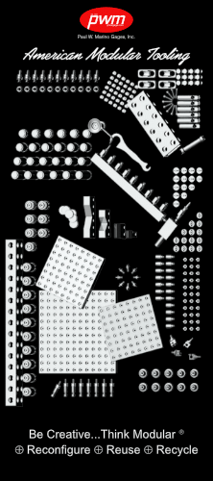
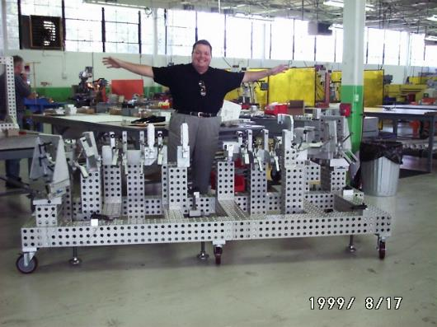
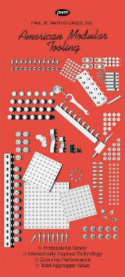
American Modular Tooling
Modular Tubing Fixtures and Kits, 1996 - 2023

Slide 2
Thank you for your time to consider American Modular Tooling, Proudly made in the United States
Who We Are
Established in 1991, Paul W. Marino Gages, Inc. (PWM) is dedicated to presenting high quality products to industry while providing reliability and service. Our mission is to supply the technological advances that embody “three E’s” – Ergonomical, Ecological, and Economical sensibilities that impact the current and future states of manufacturing and our planet.
American Modular Tooling: Fast, reconfigurable parts fixturing, rapid tool development, simplified machining, and fast assembly, disassembly and reassembly make AMT an ideal addition to the worldwide movement to lean, efficient methods of manufacturing. Every element has been designed for maximum efficiency and cross-system adaptability. Components are available individually, in kits or as complete fixtures designed and built per your part print. Be Creative…Think Modular.
Styli and Accessories: PWM's diverse stylus and accessory designs and materials maximize strength, working length and accessibility according to your requirements. High quality CMM styli and accessories for all major probing systems - standard configurations, or custom builds to your specifications.
Measurement and Standards: When it comes to accuracy, our Measurement Standards have been adopted in many nations and government institutions and will “set your standard” too. Our standards provide precision methods of accuracy in assuring measurement integrity. Step gages, sphere plates, ball bars, optical standards, gage bars, gage blocks and more are available.
“Be Creative…Think Modular”

Slide 3
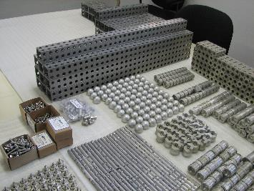
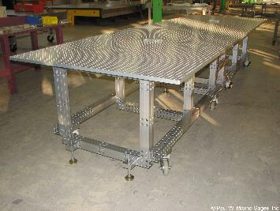
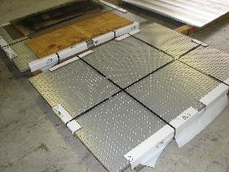
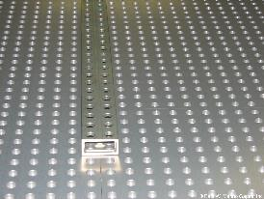
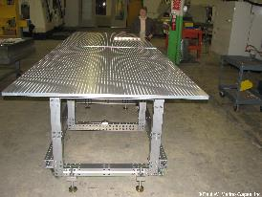
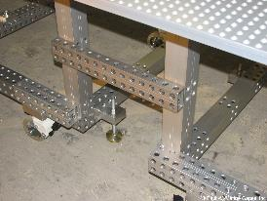
Northrop Grumman Drone AMT kit application, for various unmanned/drone aircraft.
Consisting of custom connecting plates, reconfigurable for multiple workstations, with plug-and-play components
for multiple size structures (application proprietary)
Example kit only

Slide 4
Northrop Grumman Drone
Courtesy: www.nationalmuseum.af.mil

Slide 5
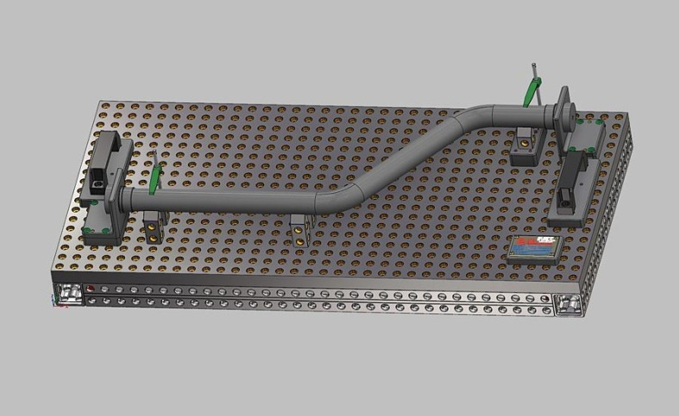
Typical CAD rendering, utilizing substructure and grid plate.

Slide 6
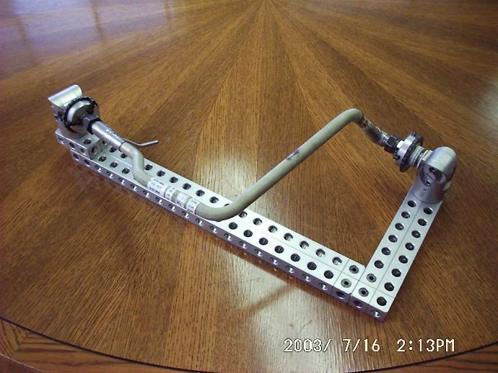
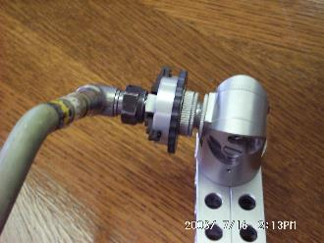
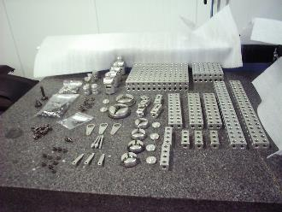
US ANG Repair Stations,
Application: F-16 (and others) fuel line inspection/work holding tool
utilizing standard plug-and-play components

Slide 7
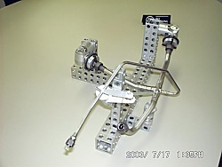
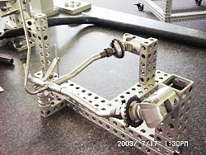
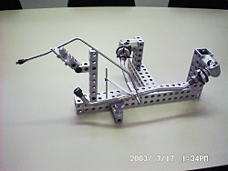
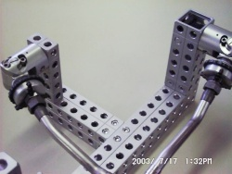
South Dakota ANG Repair Facility.
Application: various fuel line fixtures for inspection and repair.

Slide 8
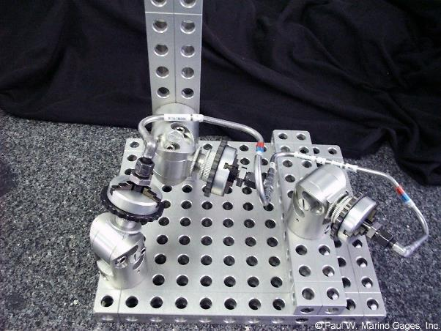
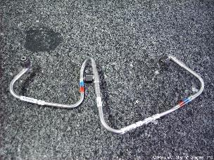
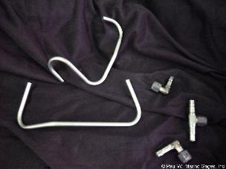
Vermont ANG Repair Facility.
Application: various fuel line fixtures for inspection and repair.

Slide 9
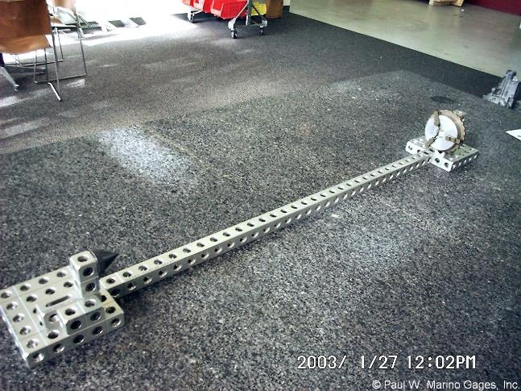
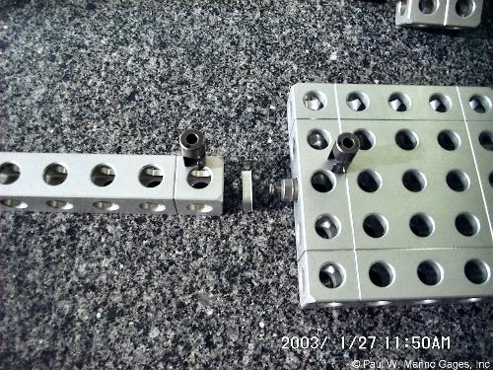
McSwain Engineering
Application: simple, long tubular part held with conical end component and rotary vise - reconfigurable, reuseable plates, and hollows for quick change.

Slide 10
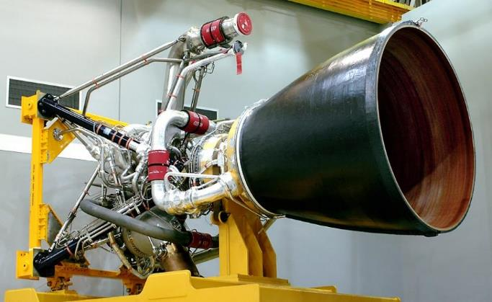
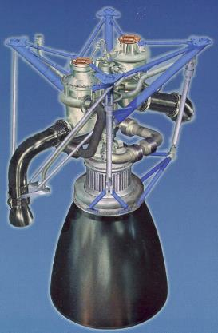
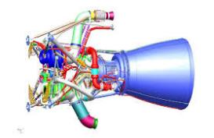
Courtesy: rocketreference.com, above left
& right.
Bottom right: The Boeing Co.
38th Joint Liquid Propulsion Concerence 2002

Slide 11
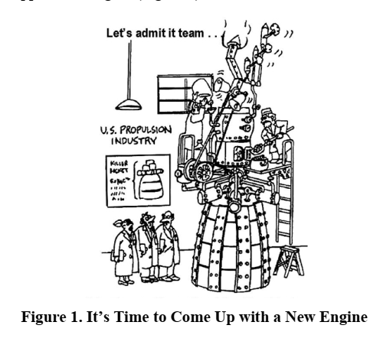
Aerospace and aircraft tube manufacturing is everchanging…making
modular tooling options a better than ever choice in manufacturing.
Courtesy: The Boeing Co.
38th Joint Liquid Propulsion Conference 2002 (pdf)

Slide 12
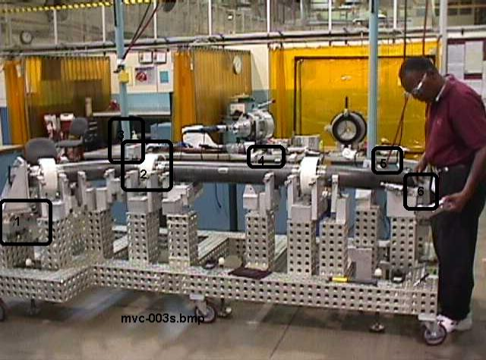
Boeing Rocketdyne RS68 Liquid Propulsion Fuel Line tubing
for orbital weld assembly and inspection.
Reuseable, reconfigurable precision design/build dedicated work holding.

Slide 13
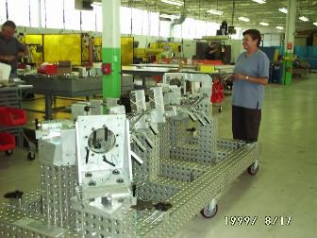
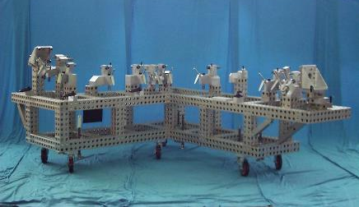
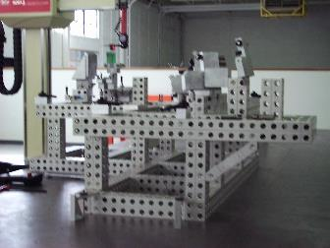
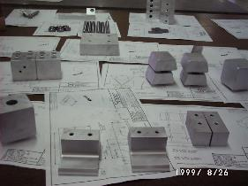
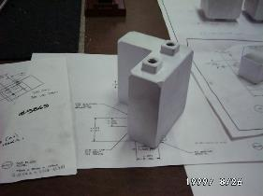
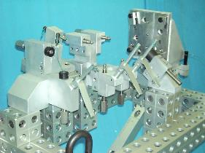
Boeing Rocketdyne RS68 Program, consisting of multiple fixtures with complete design, build, and certification
services. All tools were designed for mobility from welding operations to assembly, including test chambers.

Slide 14
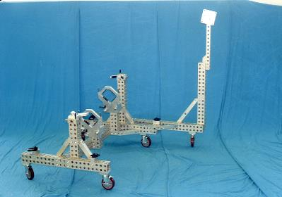
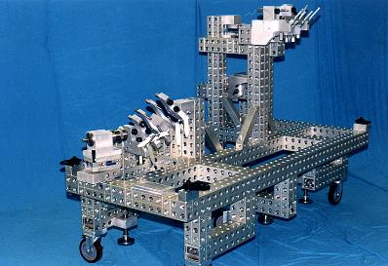
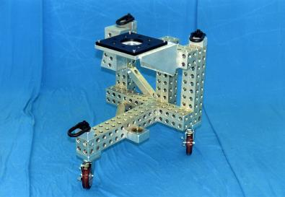
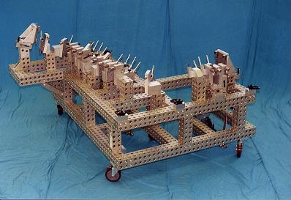
RS68 Project consisted of full assembly and sub-assembly/transport “helper” tools for easy mobility.

Slide 15
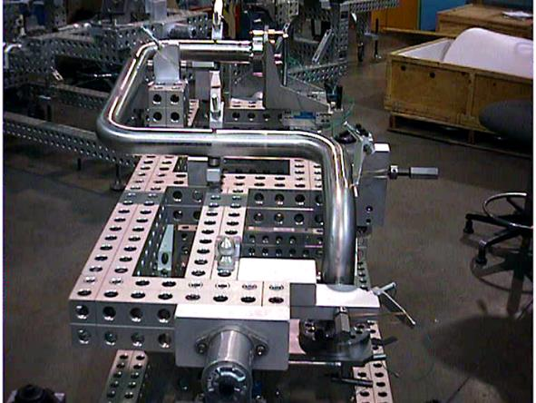
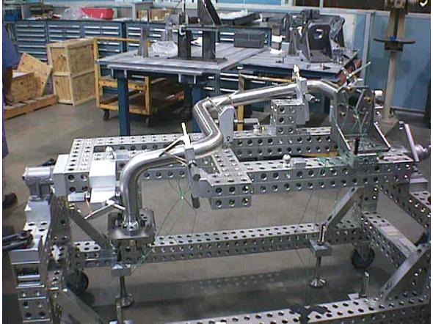
Boeing Rocketdyne RS68 fixture with trunnion for rotation and ergonomic assembly.
All large fixtures using AMT 40, our robust system for large part accuracies and capabilities.

Slide 16
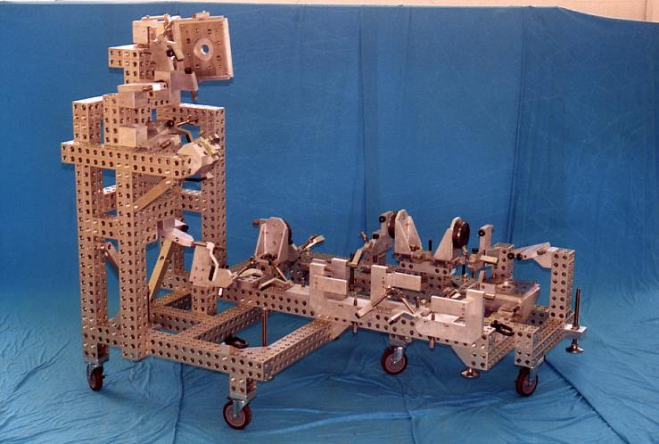
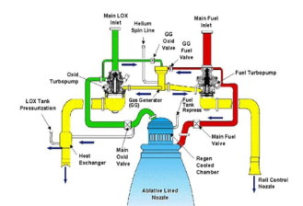
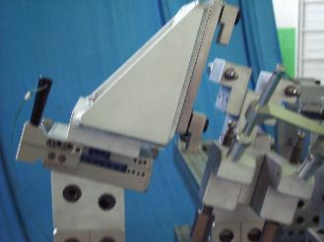
Boeing RS68 LOX, example
Courtesy: The Boeing Co. 38th Joint Liquid Propulsion Conference 2002

Slide 17
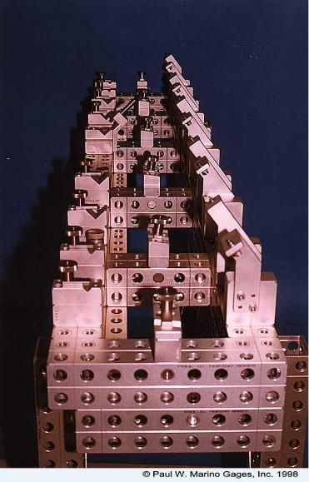
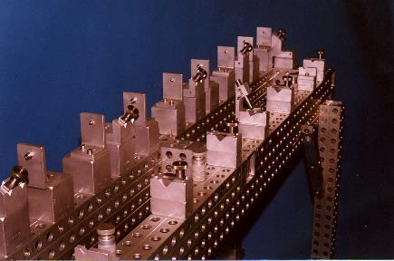
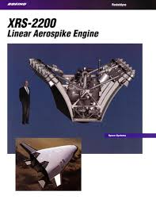
Boeing Rocketdyne Reuseable Launch Vehicle (RLV)
Tubing Assembly/Weld Fixture for small fuel lines.
Utilizing standard components and custom designed and
machined, removable net/clamping components.
Always reconfigurable and reuseable.
Courtesy: https://www.heroicrelics.org

Slide 18
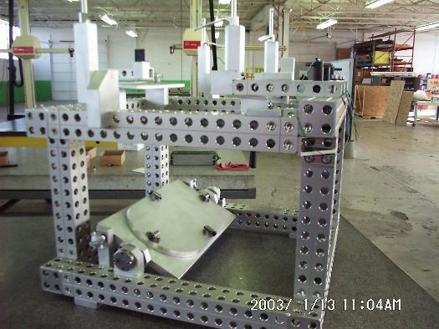
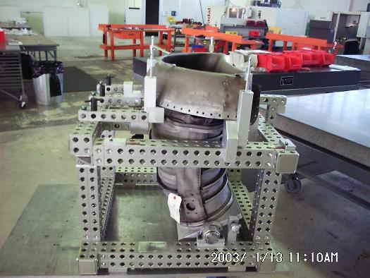
Martin-Marietta Repair Station – Fighter Jet Duct

Slide 19
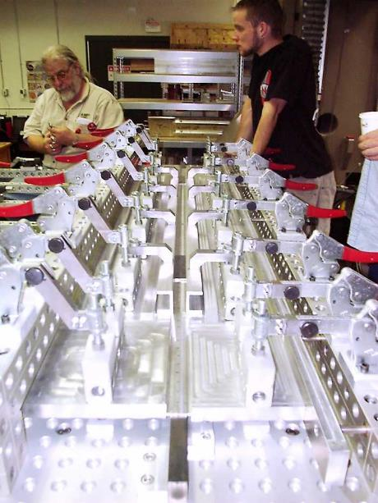
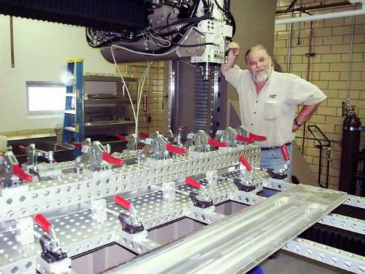
South Dakota School of Mines, FSW (“friction
stir welding” technology) for bonding to mating
parts utilizing modular tooling with custom locators.

Slide 20
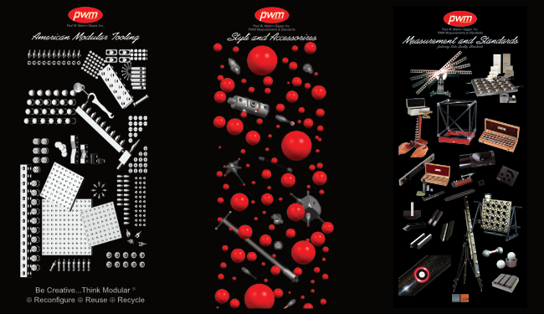
ASK us why…we have the world’s finest CMM Accessories, since 1991
See more at pmargage.com

Slide 21
Press
American Modular Tooling:
​
Modular Tooling Keeps on Truckin', Quality Magazine, September 2021
Modular Fixturing for Clay Model Making Today, Quality Magazine, March 2020
Fixturing 101: The Sky's the Limit, Quality Magazine, July 2019
Modular Fixturing: How It Works, Quality Magazine, January 2018
Modular Tooling Evolves, Quality Magazine, April 2017
Quality 101: Modular Fixturing Takes Off, Quality Magazine, March 2009
Case Studies: A Modular Fix, Quality Magazine, June 2008
Simplicity Key to CMM Fixturing, Quality Magazine, February 2004
American Modular Tooling Full Line Catalog
American Modular Tooling Studio Tools Catalog
Styli and CMM Accessories:
​
Five Steps to Selecting Styli, Quality Magazine, February 2009
Probes Push CMMs Forward, Quality Magazine, May 2003
CMM Styli and Accessories Full Line Catalog
Measurements and Standards:
​
What is Uncertainty? In Metrology, It's Truly a Deep, Sensitive Subject, Quality Magazine, May 2022
Measurement and Standards Full Line Catalog

Slide 22
If you would like more information about American Modular Tooling or to schedule a demonstration please visit our web sites or contact us with any method below and we’ll be happy to assist you.
American Modular Tooling
Paul W. Marino Gages, Inc. PWM Measurement & Standards, LLC 1 SE Ocean Blvd. Stuart, FL 34994 USA Phone: 313.300.0134
Email: pwminc@pmargage.com Web: pmargage.com / shoppwm.com Linda Goodwin-Marino, President Email: lmarino@pmargage.com
Technical Sales & Consultation Woman Owned Small Business
The contents of this presentation are confidential and are copyrighted by Paul W. Marino Gages, Inc., except where otherwise noted. AMT and American Modular Tooling are registered trade names of Paul W. Marino Gages, Inc., use by permission only.

